Slide 1
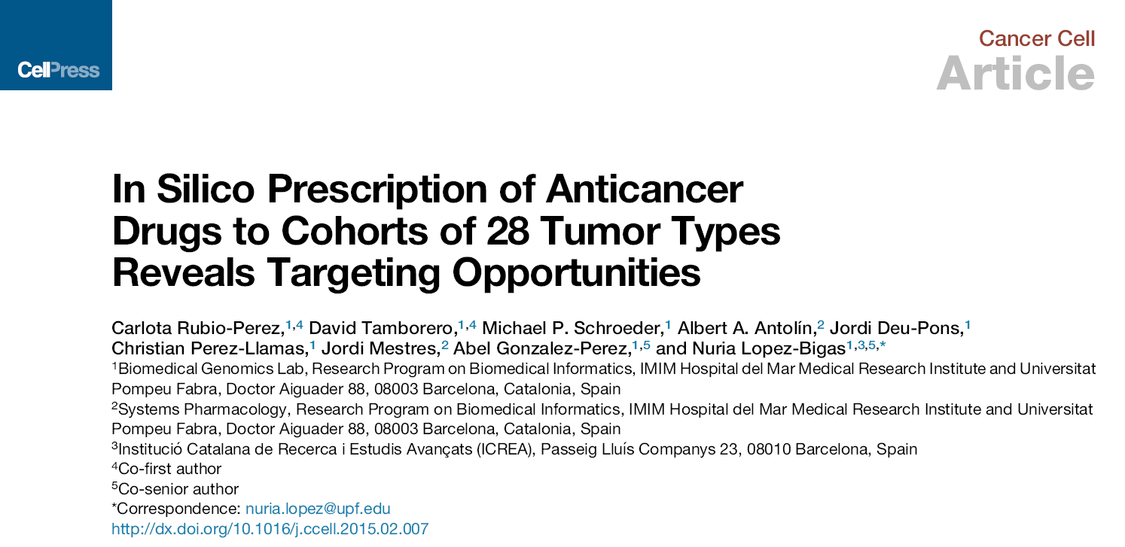
Paper Introduction
Dongfang Wang

Slide 2
Background and Contribution
Molecular characterization efforts like TCGA have laid the foundation
for Precision Oncology
Current Challenge remains to associate molecular alterations with
therapies in the appropriate clinical context.
Contributions of this study:
1. demonstrate the potential of targeted therapy on a large cohort of patients
2. provide repurposing strategies for existing drugs

Slide 3
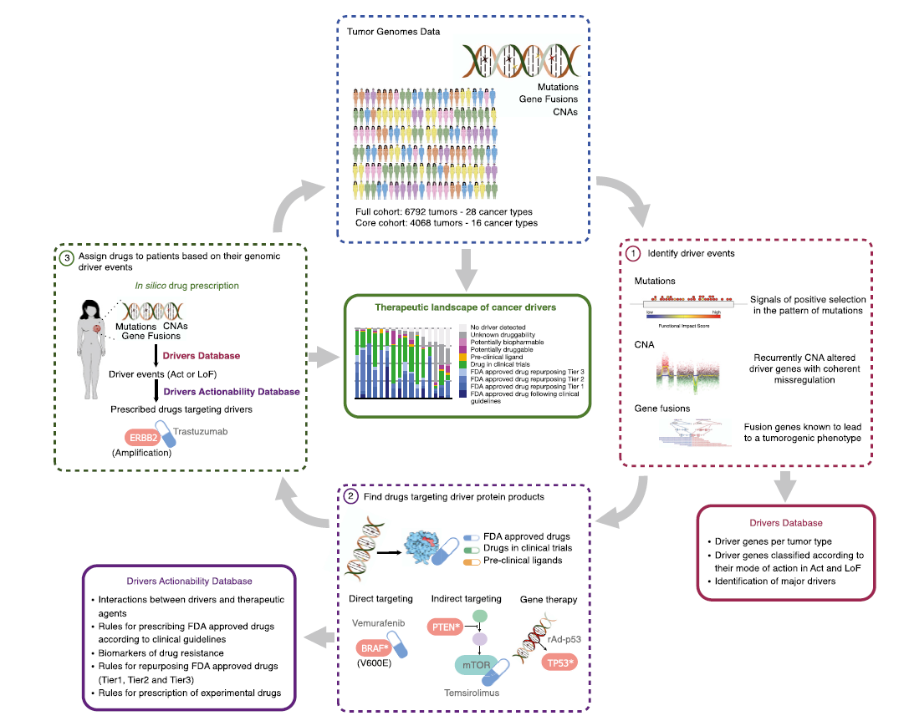
Summary of Approach

Slide 4
1. Identify Driver Events

Slide 5
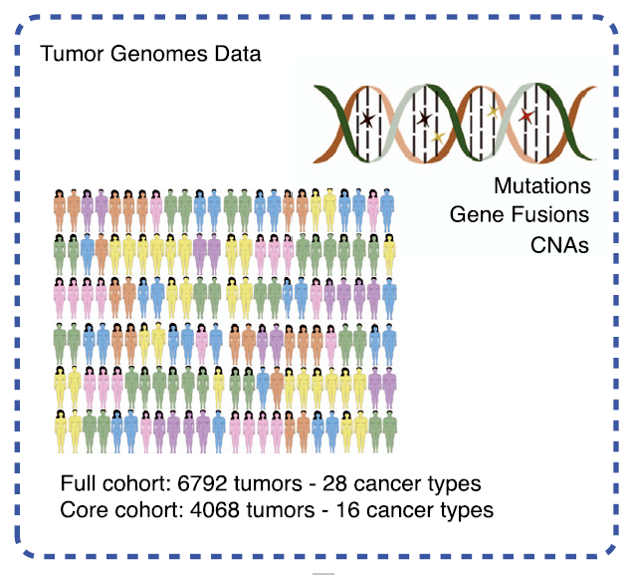
Data Collection
Core cohort: 4,068 tumors of 16 cancer types from TCGA
Addition: 2,724 tumors of 28 cancer types from 32 exome seq studies
// TCGA and
non-TCGA mutations only

Slide 6
Procedure
Complete a landscape of driver genes:
0. Identify 459 “driver” genes (Use 3 statistical methods)
1. Classified these into loss of function or activating
2. Identify “major driver genes”
3. Identify genes acting via CNA or fusion genes

Slide 7
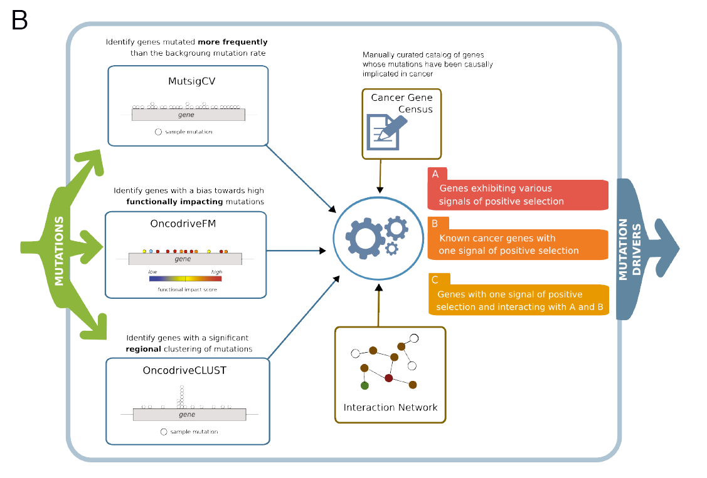
1.0 Driver Events
All the alterations driving tumorigenesis in a patients’ tumor:
Challenge: high heterogeneity and long tail with very low frequency
Assumption: genes provide a selective advantage to tumor cells
//Overlap with previously reported drive genes range 40%-75%

Slide 8
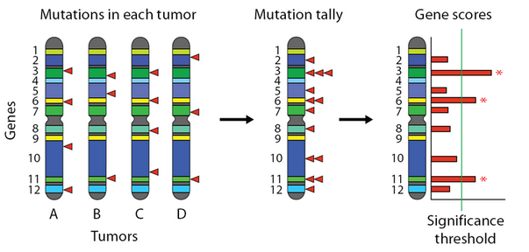
1.0.1 MutSigCV
Identify genes mutated at frequencies significantly above the background mutation rate
Key : Background Mutation Rate (BMR)
* Lawrence et al., Nature 2013

Slide 9
Backgroud Model
Abundance
1.0: A constant BMR across the genome
1.5: Estimate per-gene BMR from analyzing silent mutations of each gene
Signals of Positive selection
2.0.1: “Clustering” of mutations in hotspots
2.0.2: functional impact of the mutation. (simply Conservation)
CV: covariates
Mutations are sparse and silent mutations are too few for BMR to be estimated with any confidence
Take into account “Neighbour” genes
Similar genomic properties: DNA replication time, chromatin state, transcription activity...

Slide 10
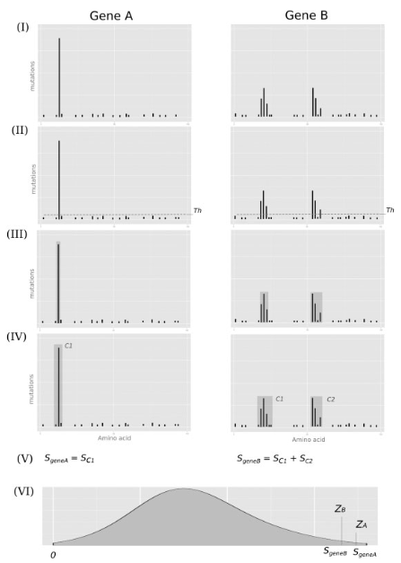
1.0.2 OncodriveCLUST
Identify genes with abnormal clustering
of mutations across the protein sequence
Assumption: Mutations in oncogenes often
cluster in particular positions of the protein
* Tamborero D et al., Bioinformatics 2013

Slide 11
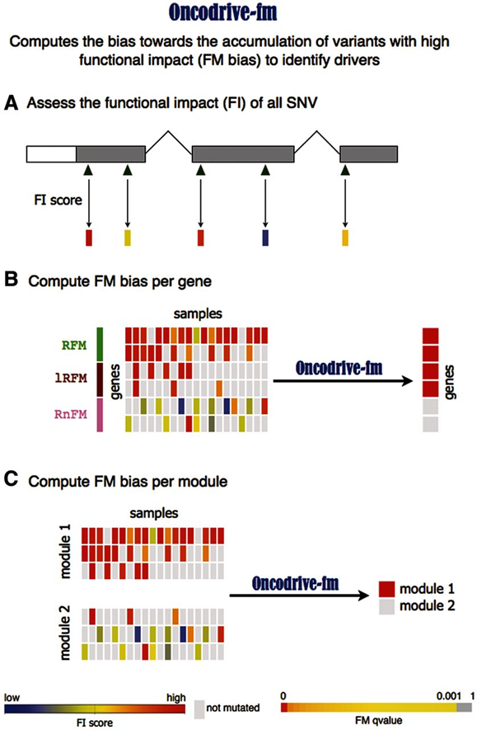
1.0.3 OncodriveFM
Identify genes biased towards the
accumulation of mutations with high
functional impact
* Gonzalez-Perez et al., NAR 2012

Slide 12
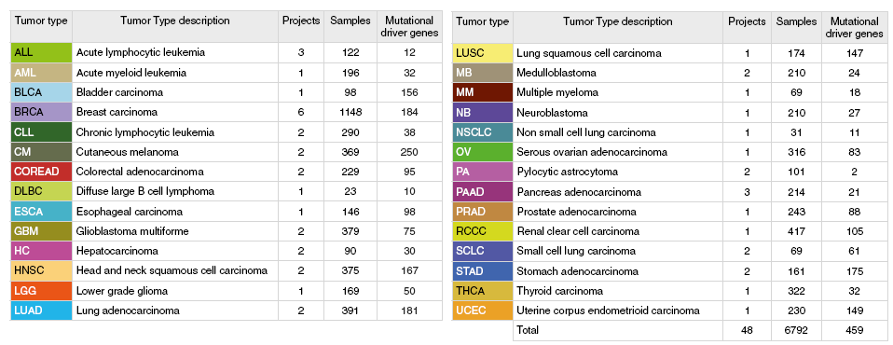
Results
459 mutational cancer driver genes across one or more tumor types
// Number of genes varies widely between tumor types

Slide 13
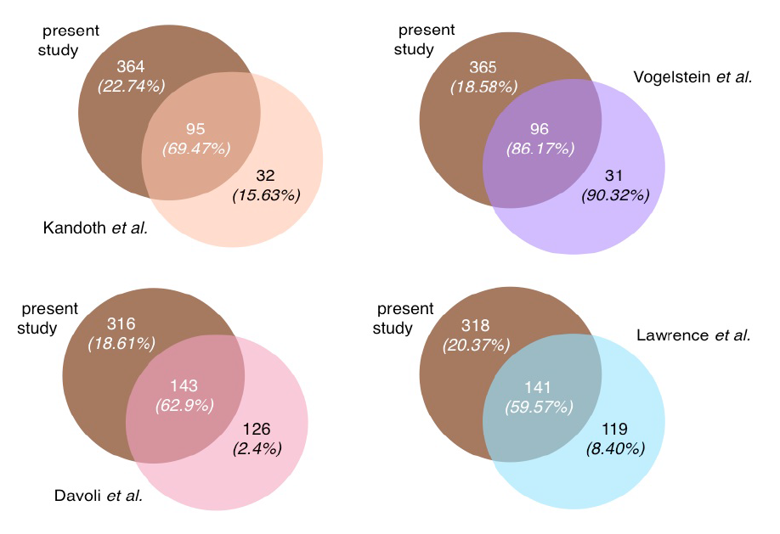
* (CGC: Cancer Gene Census)
//Many novel candidates (more are yet to be identified?)

Slide 14
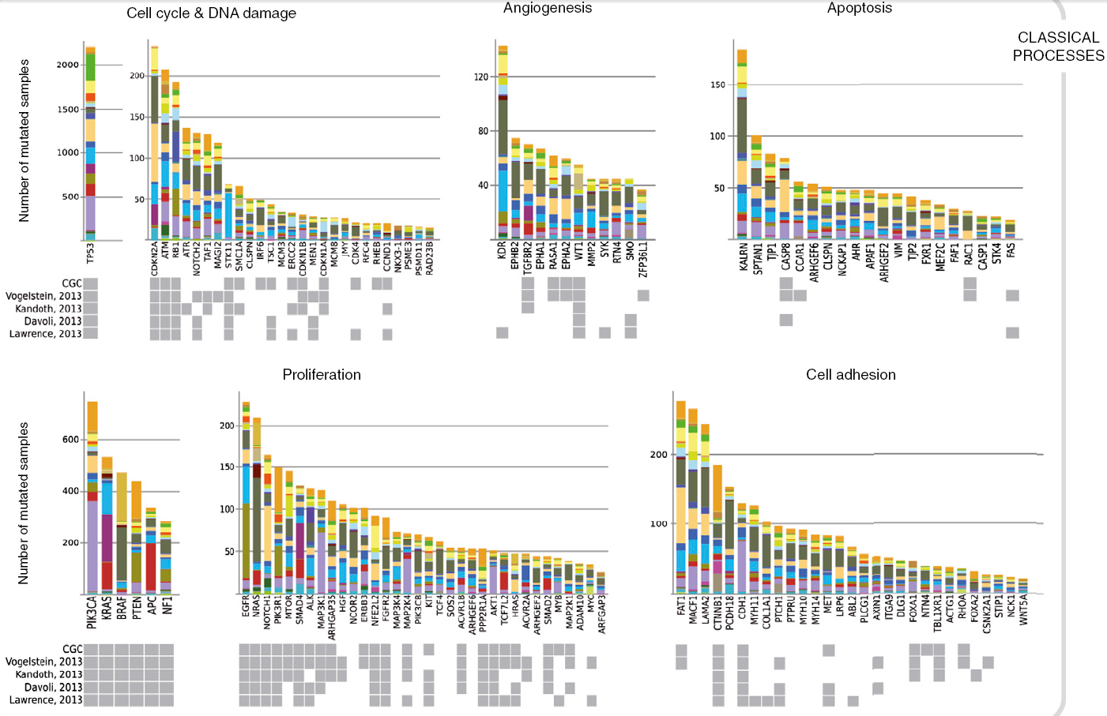
// Involved in well-known cancer pathways

Slide 15
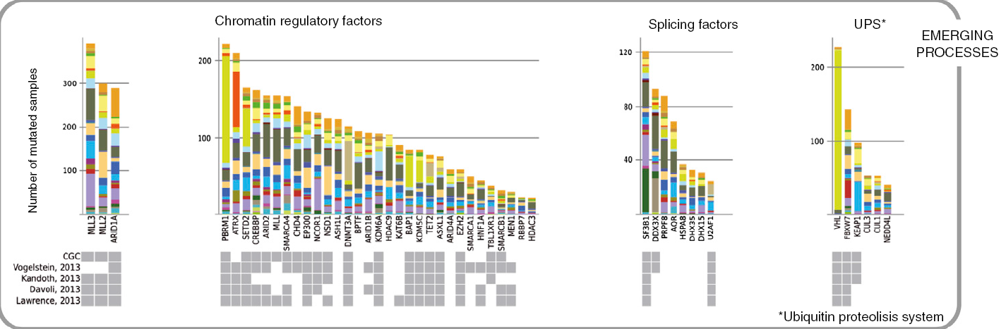
// 25% Involved in general cell-regulatory processes

Slide 16
1.1 Mode of Action
Three groups:
loss of function (LoF) (tumor-suppressor genes)
gain of function(GoF) (oncogenes)
switch of function(SoF)
Help explore opportunities to therapeutically target
Act(2+3): directly target to inhabit their functions
LoF: other strategies (e.g. inhibition of a functionally connected genes)

Slide 17
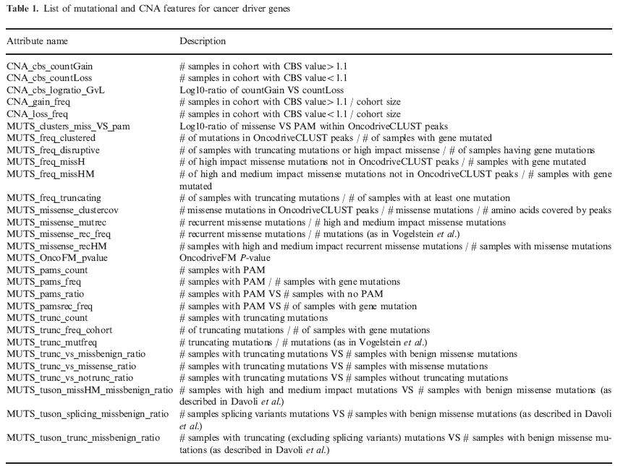
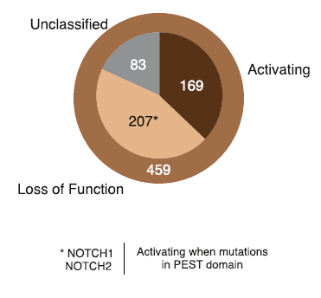
OncodriveROLE
Random forest classifier to indentify the mode of action
Training set: CGC (known 28+45)
* Schroeder et al., Bioinformatics 2014

Slide 18
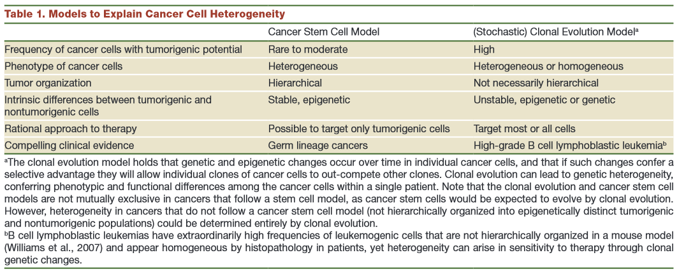
1.2 Major Driver Genes
Not all driver genes are equally important
Some provide basic capabilities (apoptosis,proliferation,...)
Some render added capabilities (further progress and migrate ...)
Major driver genes: dominate the clonal population of these tumors
http://en.wikipedia.org/wiki/Somatic_evolution_in_cancer
* Shackleton et al., Cell 2009

Slide 19
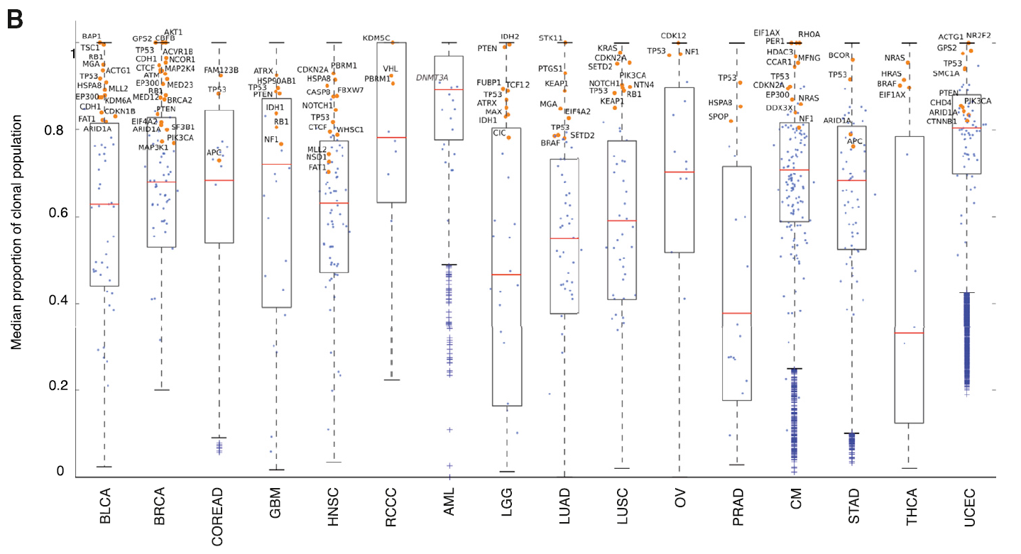
// 73 major genes (biased toward large clonal frequencies)

Slide 20
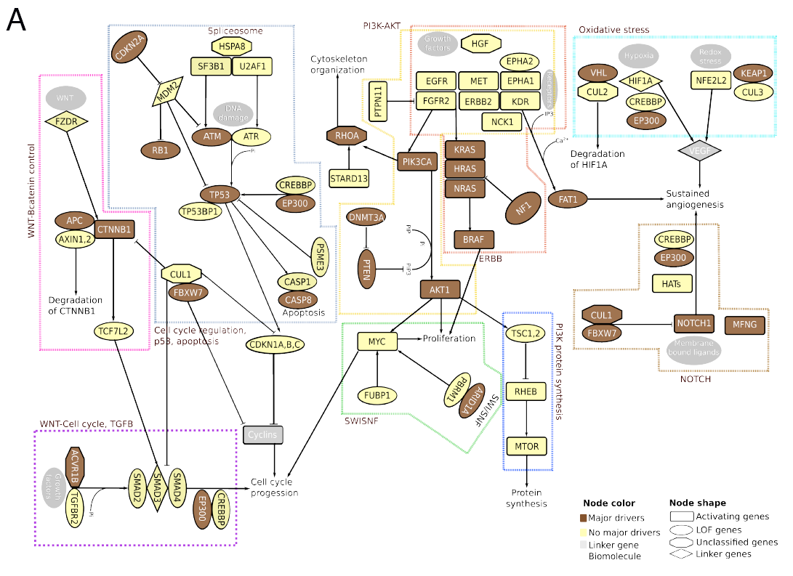
// functional modules

Slide 21
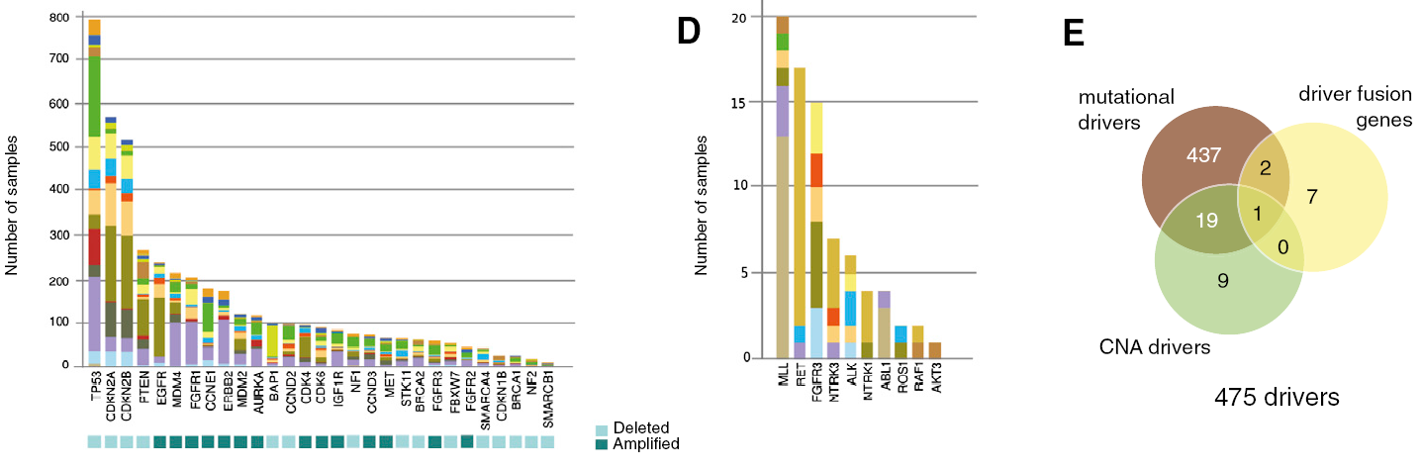
1.3 Acting via CNA or Fusion genes
CNA: manually select targeted genes located within recurrently amplified or deleted segments identified by GISTIC analysis
Fusion genes: manually cruating the literature
// 459+29+10

Slide 22
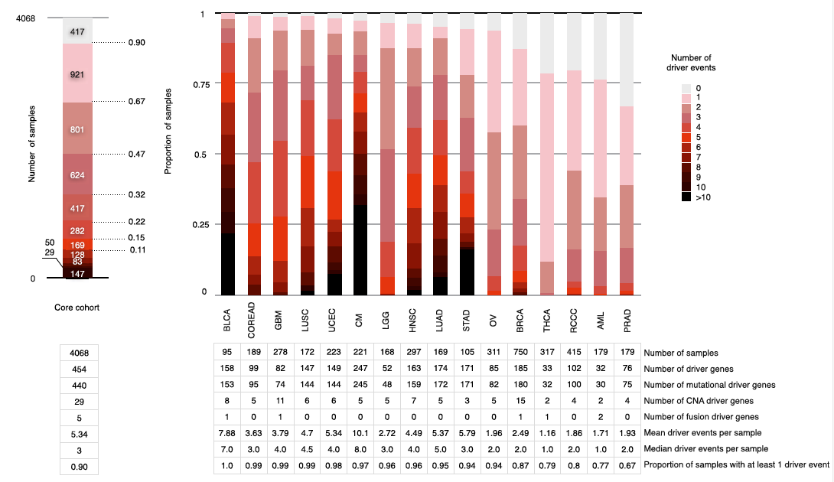
1.4 Cancer Driver Database

Slide 23
2. Collecting Drugs

Slide 24
2.1 Collecting Drugs
Exhaustively searching for therapeutic options:
Approved by FDA
In clinical or pre-clinical studies
Targeting driver genes:
Direct targeting //inhibition of activated drivers with therapeutic molecules (ChEMBL)
Indirect targeting //inhibition of non-altered functionally connected to altered. ..(TARGET)
Designed to compensate for LoF drivers
(The Journal of Gene Medicine Clinical Trial)
Other relevant information

Slide 25
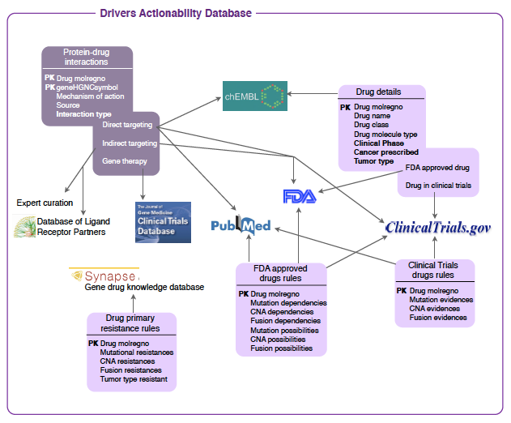

Slide 26
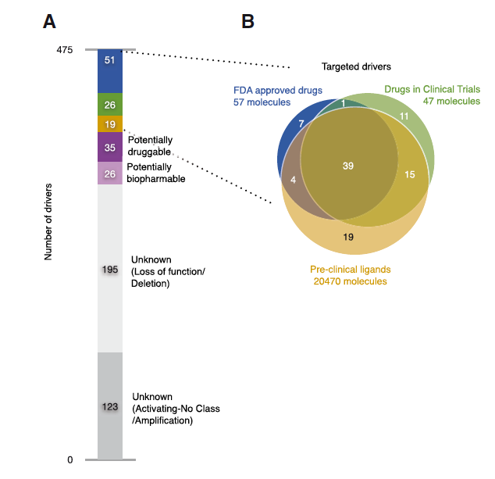
// 96 targeted drivers
// 35 Potentially druggable:
protein structure suitable for small molecule binding
// 26 Potentially biopharmable:
Accessed by antibody and protein therapies

Slide 27
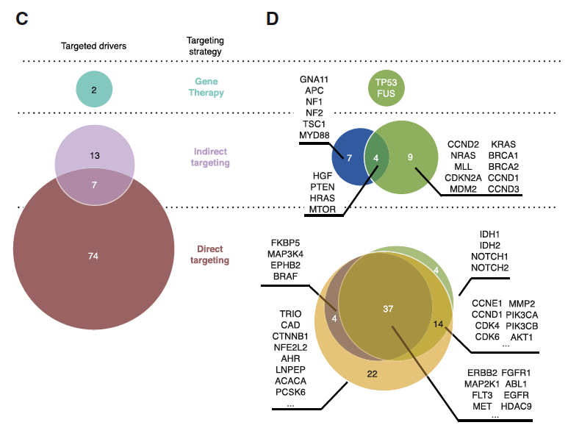
// 3 different levels of approval as B (FDA,…)

Slide 28
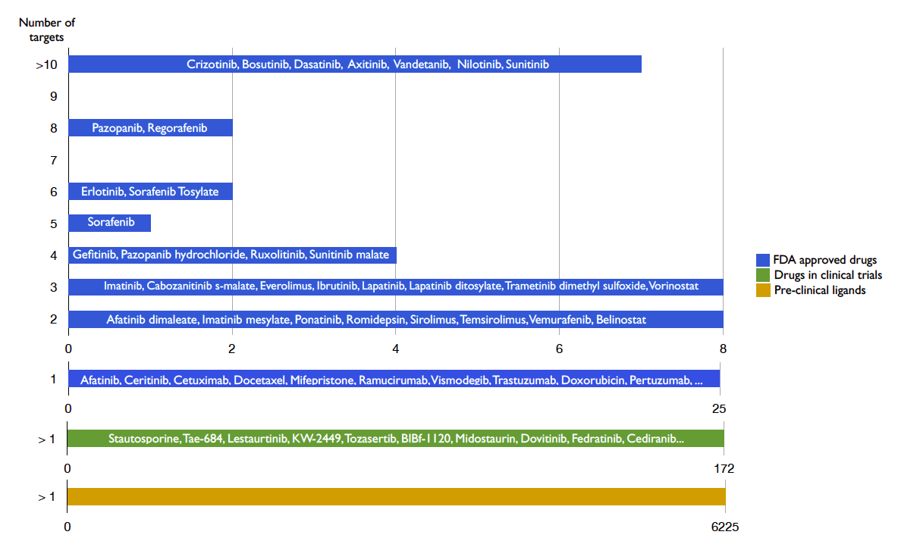
//FDA:32 of 57 targets 2-17 drivers

Slide 29
2.2 Cancer Drivers Actionability Database
This database contains data on the interactions with therapeutic agents an driver genes contained in Cancer Drivers Database (2014.11).
1. Rules for prescribing FDA approved drugs according to clinical guideline
2. Biomarkers of drug resistance
3. Rules for repurposing FDA approved drugs
4. Rules for prescribing of experimental drugs

Slide 30
Clinical Guidelines
Target agent (primarily one driver gene)
Tumor type (one or few malignancies)
Alteration type (a particular type e.g. C-T)
Specific alteration (a particular mutation residues)
Interacting alteration (primary drug response …)

Slide 31
Drug Repurposing Rules
Tier1
(most likely)
1.Tumor type (different than considered in clinical guide)
2.Disease(can target cancer driver protein)
Tier2
1.Alteration(from the same gene)
2.Indirect target(counteract the alteration in connected..)
3.Strong off-target(bind more potently than drug primary..)
Tier3
3.Mild off-target(bind less potently but more than 1uM)

Slide 32
Evaluation
In silico drug prescription strategy relied heavily on drug repurposing
How to validity?
e.g. 154 GBM(40.6%) with amplification of EGFR, which are predicted to respond to dasatinib(达杀替尼) and lapatinib(拉帕替尼), while this strategy notoriously failed to produce significant outcome benefits in clinical trials.

Slide 33
3. Connecting Targeted Therapeutic Agents to Patients

Slide 34
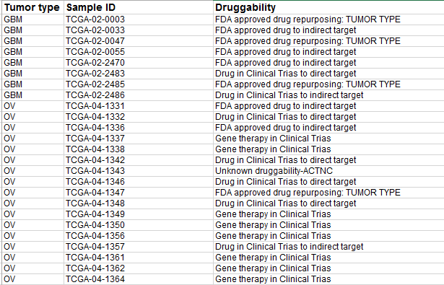
3.1 Therapeutic Landscape
Given a patient, select the driver alterations on the basis of the Cancer Driver Database
Through Cancer Drivers Actionability Database, therapies are matched to those alterations (interaction and rules)

Slide 35
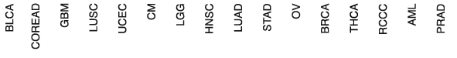
3.2 Drug repurposing 0
Approved Targeted Therapies Could Benefit 5.9% of the Patients in the
Core Cohort (4068 * 5.9% = 241)
ERBB2: Lapatinib, Pertuzumab, Trastuzumab

Slide 36
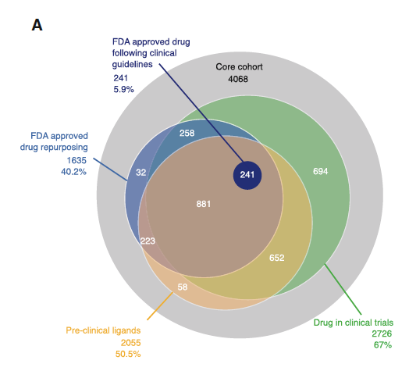
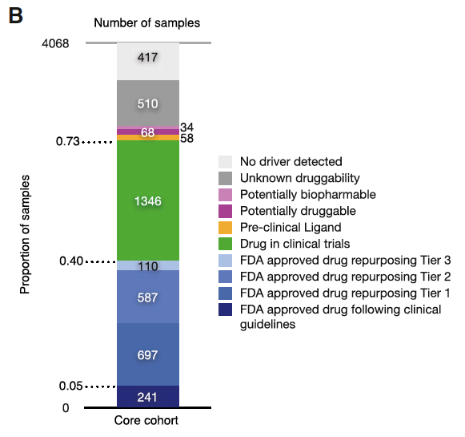
3.2 Drug repurposing 1
Drug Repurposing Increases up to 40.2% the Fraction of Patients that
Could Benefit from FDA-Approved Drugs
1163
867
835

Slide 37
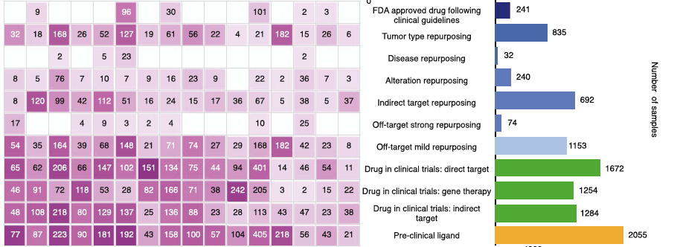
3.2 Drug repurposing 2
1.346 or 33.1% Further Patients in the Cohort Could Benefit from
Drugs Currently Under Clinical Trials

Slide 38
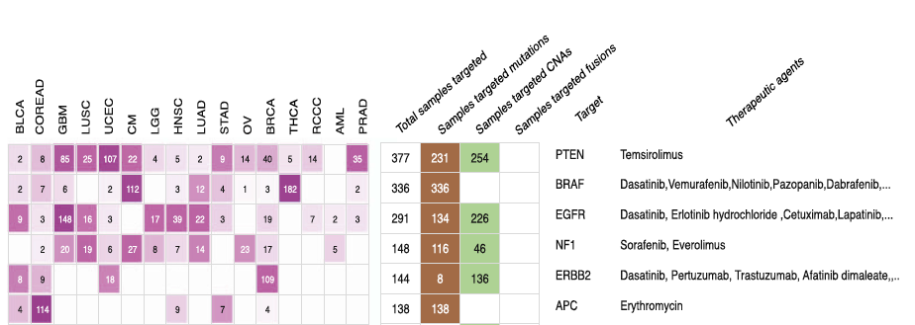
//FDA
//Clinical trial

Slide 39
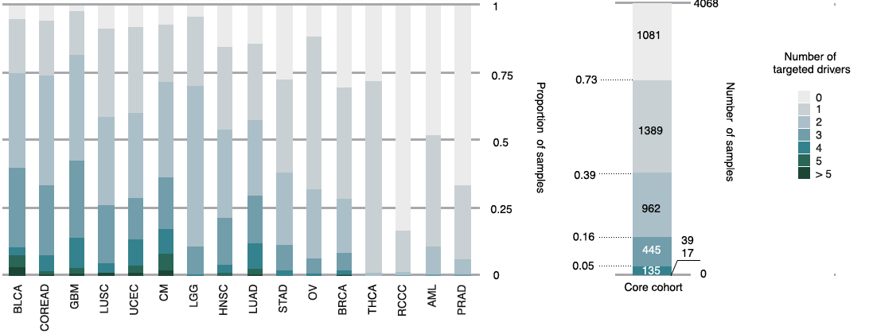
3.3 Combination Therapies
Combination of multiple agents //improve efficiency and diminish resistance
39% (1598/4068) receive multiple agents against multiple drivers

Slide 40
Summary

